Slide 1

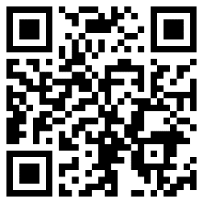

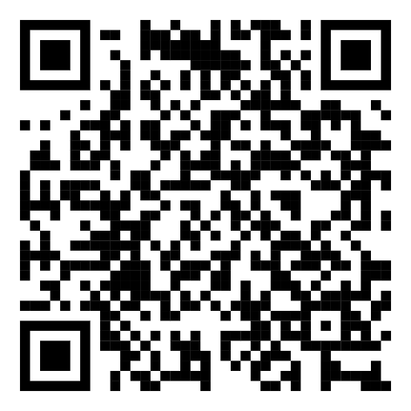

SI-PASS/PAL
ONLINE LEADER DEVELOPMENT ACTIVITIES
ACTIVITIES AUTUMN 2024:
LinkedIn group
For a unique chance to network with Leaders from across Europe, join our LinkedIn group by scanning this QR-code or by searching
“SI-PASS/PAL Leaders in Europe” on LinkedIn
30TH OCTOBER, 12-1PM GMT/ 1-2PM CET
Favourite Learning Strategies –how to make your sessions fun and engaging!
Certified Trainer and SI-PASS supervisor Jill Jaworski from the Canadian SI center will guide us through discussions around how to use new learning strategies to make the sessions more varied.
26TH NOVEMBER, 3-4 PM GMT/4-5PM CET
Wisdoms & Lessons Learnt –experiences of leading sessions & developing in the role
Discussions and activities led by Dennis Nilsson, an experienced SI-PASS Leader at Lund University.
ZOOM-link: https://lu-se.zoom.us/j/69043714309
WHAT ARE THE ONLINE LEADER DEVELOPMENT ACTIVITIES?
FOCUS ON CONTINUING PROFESSIONAL DEVELOPMENT (CPD) FOR SI-PASS/PAL LEADERS
NETWORKING OPPORTUNITY
HOW DOES IT WORK?
  FREE TO ATTEND FOR SI-PASS/PAL LEADERS
  SIGN UP VIA THE QR CODE (encouraged but not required)
  HOSTED ON ZOOM BY THE
EUROPEAN CENTER FOR SI-PASS/PAL

